Slide 1


PANIMALAR ENGINEERING COLLEGE
Department of Computer Science and Engineering
Intrusion Detection system for Cloud Environments based Supervised Machine Learning Algorithms
Team Members with Register number
JEBINESH E H [Register No:211417104094]
HRITISH.S [Register No:211417104086]
GOKULAKRISHNAN. P [Register No:211417104070
Project Guide:
M.KRISHNAMOORTHY
ASSISTANT PROESSOR,
DEPARTMENT OF CSE,
PANIMALAR ENGINEERING COLLEGE

Slide 2
Intrusion Detection system for Cloud Environments based Supervised Machine Learning Algorithms

Slide 3
Abstract
There are many risks of network attacks under the Internet environment. Internet Security is a vital issue and therefore, the intrusion detection is one major research problem for business and personal networks to resist external attacks.
A Network Intrusion Detection System (NIDS) is a software application that monitors the network or system activities for malicious activities and unauthorized access to devices. The goal of designing a NIDS is to protect data’s confidentiality and integrity.
Our project focuses on these issues with the help of supervised Machine Learning algorithm To learn the patterns of the attacks, NSL-KDD dataset has been used.

Slide 4
Objectives
The Main Objective of the project is designing a NIDS is to protect data’s confidentiality and integrity. Our project focuses on these issues with the help of Machine Learning.

Slide 5
Introduction
An intrusion can be defined as “any set of actions that attempt to compromise the:
Integrity
confidentiality, or
availability of a resource”.

Slide 6
Types of Attacks
Eavesdropping
In general, the majority of network communications occur in an unsecured or "clear text" format, which allows an attacker who has gained access to data paths in your network to "listen in" or interpret (read) the traffic.
Data Modification
After an attacker has read your data, the next logical step is to alter it. An attacker can modify the data in the packet without the knowledge of the sender or receiver. Even if you do not require confidentiality for all communications, you do not want any of your messages to be modified in transit. For example, if you are exchanging purchase requisitions, you do not want the items, amounts, or billing information to be modified.

Slide 7
Identity Spoofing (IP Address Spoofing)
Most networks and operating systems use the IP address of a computer to identify a valid entity. In certain cases, it is possible for an IP address to be falsely assumed— identity spoofing.
Sniffer Attack
A sniffer is an application or device that can read, monitor, and capture network data exchanges and read network packets. If the packets are not encrypted, a sniffer provides a full view of the data inside the packet.

Slide 8
Application-Layer Attack
An application-layer attack targets application servers by deliberately causing a fault in a server's operating system or applications.
Password-Based Attacks
A common denominator of most operating system and network security plans is password-based access control. This means your access rights to a computer and network resources are determined by who you are, that is, your user name and your password.

Slide 9
Man-in-the-Middle Attack
As the name indicates, a man-in-the-middle attack occurs when someone between you and the person with whom you are communicating is actively monitoring, capturing, and controlling your communication transparently.

Slide 10
Existing system
A false positive is a situation where something abnormal (as defined by the IDS) happens, but it is not an intrusion.
User will quit monitoring IDS because of noise.
No Confidentiality. Not an real time network data implemented.

Slide 11
Existing Disadvantages
No Data confidentiality
No Data integrity
Less prediction accuracy.
Not an real time analysis.
Existing system not used for an long dataset.
The prediction of identity malicious activity is not much accurate.

Slide 12
Machine learning in IDS
The pattern of the normal activities and malicious activities can be learned and distinguished.
Machine learning can result in higher detection rates, lower false alarm rates.
On dynamic data, the model can be updated and maintained.

Slide 13
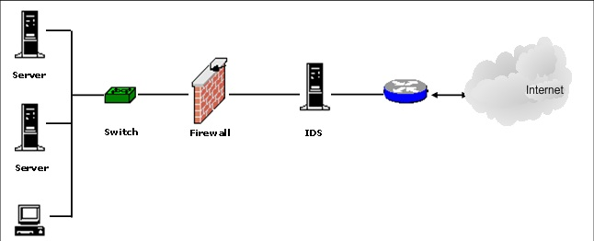
Block Diagram of IDS

Slide 14
Proposed system
This research focuses on solving the issues in intrusion detection communities that can help the administrator to make pre-processing, classification, labeling of data and to mitigate the outcome of Distributed Denial of Service Attacks.
Since, the network administrator feels difficult to pre-process the data. Due to the overwhelming growth of attacks which makes the task hard, attacks can be identified only after it happens. To overcome this situation, frequent updating of profiles is needed.
Reduced workload of administrator increases the detection of attacks.

Slide 15
Advantages
When designing a IDS, the mission is to protect the data’s
Confidentiality – read
Integrity – read/write
Real time data analytics.
High accuracy.

Slide 16
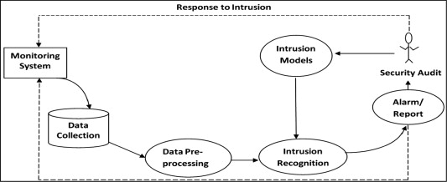
Architecture diagram

Slide 17
Hardware requirements:
Processor - Intel Pentium
RAM - 4 GB
Hard Disk - 500 GB
Monitor – SVGA
Software requirements:
Python 3.8
Jupiter notebook.

Slide 18
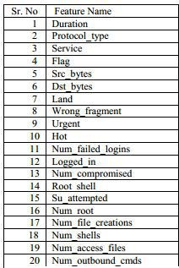
Dataset parameters

Slide 19
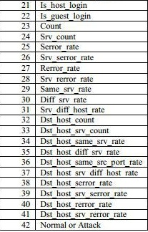

Slide 20
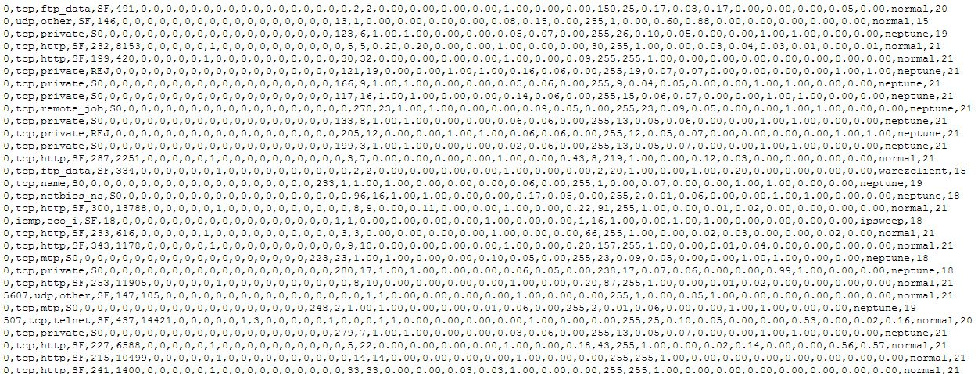
Dataset sample

Slide 21
Modules
1. Data collection.
2.data preprocessing.
3.machine learning algorithm
4.Training and testing

Slide 22
Modules description
1. Data collection
Real time data collected from Twitter ,kaggle, UCI , Data.gov,NSL-KDD dataset
Collection of data is one of the major and most important tasks of any machine learning projects. Because the input we feed to the algorithms is data. So, the algorithms efficiency and accuracy depends upon the correctness and quality of data collected. So as the data same will be the output.

Slide 23
Data preprocessing
As you can see, the dataset contains nominal values also and to train a model we need all numerical values.
Here is the transformation table that we used.
Dataset is very large and there is a large variation between values, Data Normalization is also required for better performance.

Slide 24
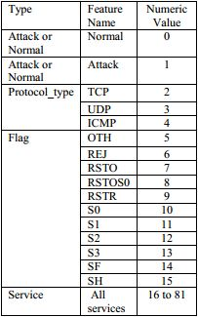
Preprocessing sample

Slide 25
Machine learning algorithm
The next step is algorithms are applied to data and results are noted and observed. The decision tree and random forest algorithm applied for accuracy at each stage.

Slide 26
Training and Testing
Finally after processing of data and training the very next task is obviously testing. This is where performance of the algorithm, quality of data, and required output all appears out. From the huge data set collected 80 percent of the data is utilized for training and 20 percent of the data is reserved for testing. Training as discussed before is the process of making the machine to learn and giving it the capability to make further predictions based on the training it took.

Slide 27
Activity diagram
Data collection
Data cleaning
Filling the data
Applying machine learning
Verify intruders detection

Slide 28
Use case diagram
Monitoring System
Data collection
Data pre-processing
user
Comparing the modules with other machine learning models
Verify intruders detection

Slide 29
Sequence diagram
kaggle
Examine machine learning
user
Data collection
Data cleaning
Analyse machine learning algorithm
Applying machine learning
Compare and send the models

Slide 30
Collaboration diagram
user
1.Data collection
kaggle
2.Data cleaning
3.Applying machine learning
4.Compare models
Machine learning algorithms

Slide 31
Conclusion
Algorithms based on Machine Learning were implemented successfully showing different accuracies.
NSL-KDD dataset was preprocessed using mean normalization method.
Linear regression, surprisingly, proved to be very effective in detecting network attacks with a high accuracy.
Neural Networks was implemented with one hidden layer one time and two hidden layers other time. With two hidden layers, it proved to be the best among all the approaches above.
But there is always a trade-off between the accuracy and time an algorithm takes. Neural Network took the most time to get trained while K-Means Clustering took lowest amount of time.

Slide 32
Reference
[1]A Dynamical Growing Self-Organizing Tree (DGSOT) for Hierarchical Clustering Gene Expression Profiles,” Feng Luo, Latifur Khan , Farokh Bastani, I-Ling Yen and J. Zhou, the Bioinformatics Journal, Oxford University Press, UK, 20 16, 2605-2617.
[2]“Automatic Image Annotation and Retrieval using Weighted Feature Selection” Lei Wang and Latifur Khan to appear in a special issue in Multimedia Tools and Applications, Kulwer Publisher.
[3]“Hierarchical Clustering for Complex Data” Latifur Khan and Feng Luo, to appear in International Journal on Artificial Intelligence Tools, World Scientific publishers.
[4]“A New Intrusion Detection System using Support Vector Machines and Hierarchical Clustering” Latifur Khan, Mamoun Awad, and Bhavani Thuraisingham, to appear in VLDB Journal: The International Journal on Very Large Databases, ACM/Springer-Verlag Publishing.
[5]R. Lippman J. Haines, D. Fried., J. Korba, and K. Das, “The 1999 DARPA off-line intrusion detection evaluation” , Computer Networks, 34, pp. 579-595, 2000.

Slide 33
Thank you

